Slide 1
NETWORK BASED ATTACKS
Sniffing
Denial-of-Service (DoS) Attack
Password Attack
Session Hijacking

Slide 2
1. Sniffing
A sniffing attack involves an attacker getting into the network data-stream and reading, monitoring or capturing full packets of data flowing between a client and a server. A hacker intercepting a network packet containing unencrypted information can cause severe damage to the organization or entity that owns the data. Data compromised may include sensitive information like account credentials, bank details, and different kinds of Personally Identifiable Information (PII). Sniffing attacks can either be active (involving both data access and manipulation) or passive (where the attacker only sees the information but does not actively interfere in its transmission). Examples of tools used for sniffing attacks are Wireshark, tcpdump, dSniff and Debookee.

Slide 3

For example Sniffing Tool-Wireshark

Slide 4
WireShark:
Wireshark is an open-source application that captures and displays data traveling back and forth on a network.
Because it can drill down and read the contents of each packet, it's used to troubleshoot network problems and test software.

Slide 5
What Is Wireshark?
Originally known as Ethereal, Wireshark displays data from hundreds of different protocols on all major network types. Data packets can be viewed in real-time or analyzed offline. Wireshark supports dozens of capture/trace file formats, including CAP and ERF. Integrated decryption tools display the encrypted packets for several common protocols, including WEP and WPA/WPA2.

Slide 6

WireShark User Guide
First download WireShark and install it on OS.

Slide 7
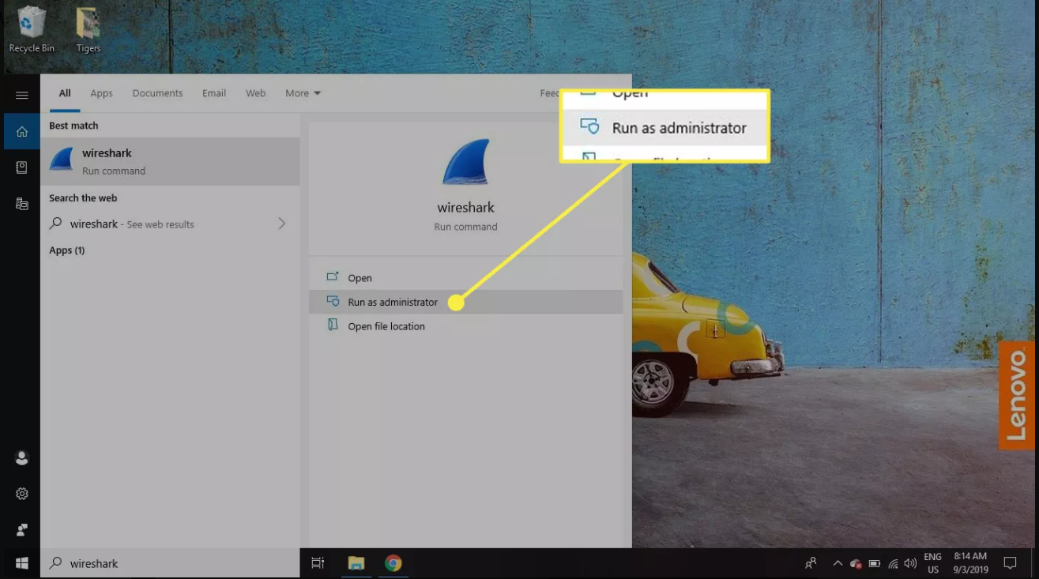
You must be logged in to the device as an administrator to use Wireshark.

Slide 8
How to Capture Data Packets With Wireshark ?
When you launch Wireshark, a welcome screen lists the available network connections on your current device. Displayed to the right of each is an EKG-style line graph that represents live traffic on that network.
To begin capturing packets with Wireshark:

Slide 9
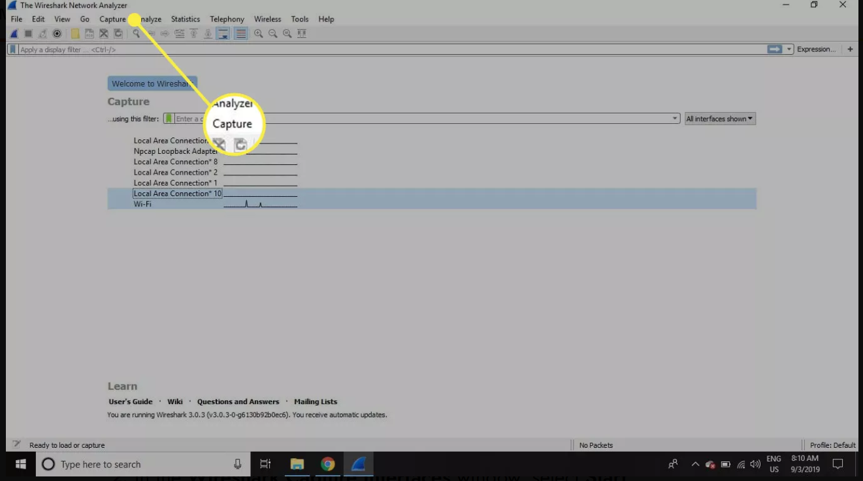
Select one or more of networks, go to the menu bar, then select Capture.

Slide 10
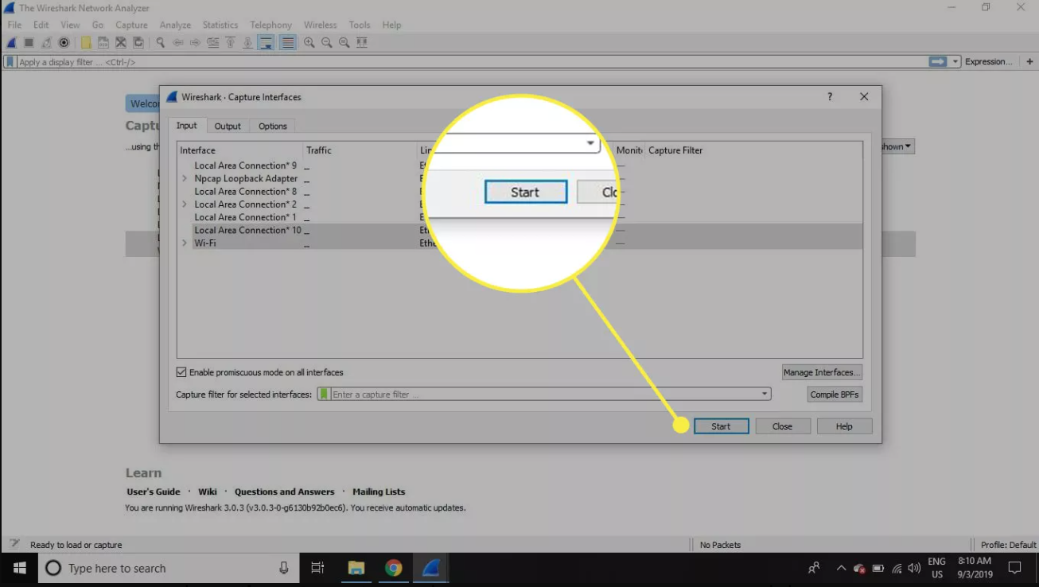
In the Wireshark Capture Interfaces window, select Start.

Slide 11
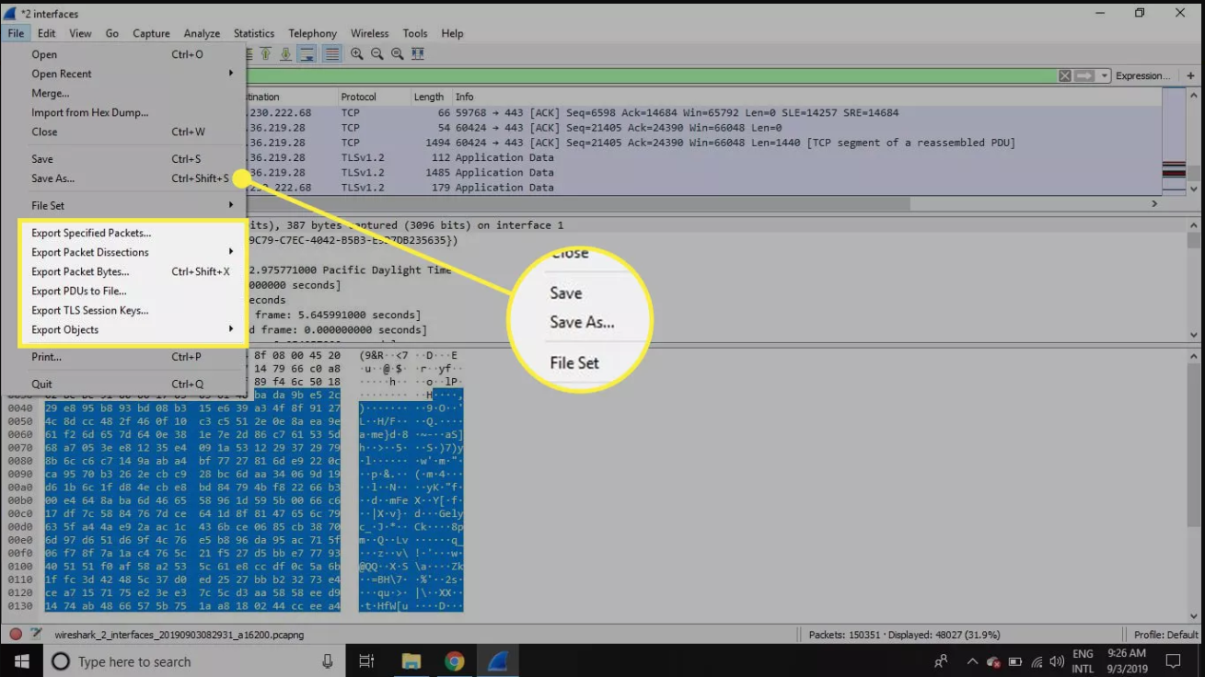
Select File > Save As or choose an Export option to record the capture.

Slide 12
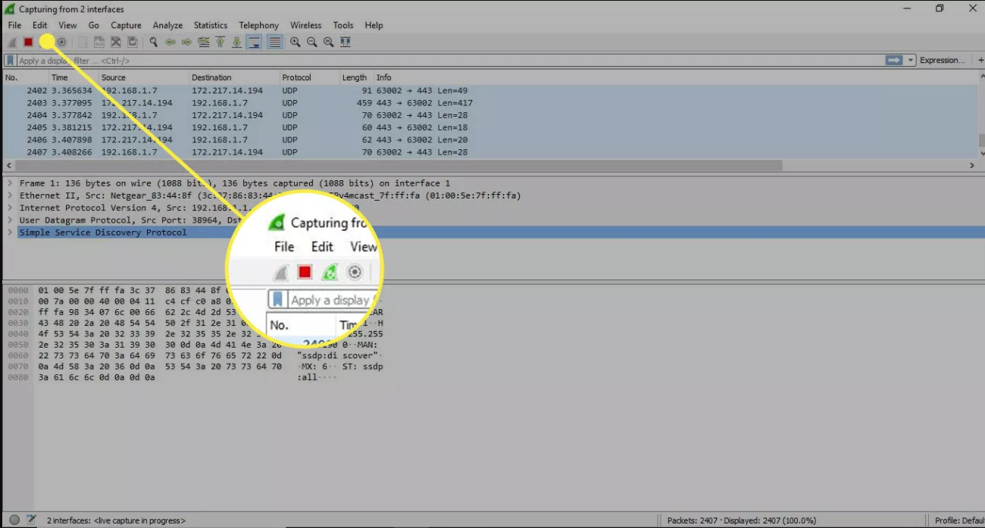
To stop capturing, press Ctrl+E. Or, go to the Wireshark toolbar and select the red Stop button that's located next to the shark fin.

Slide 13
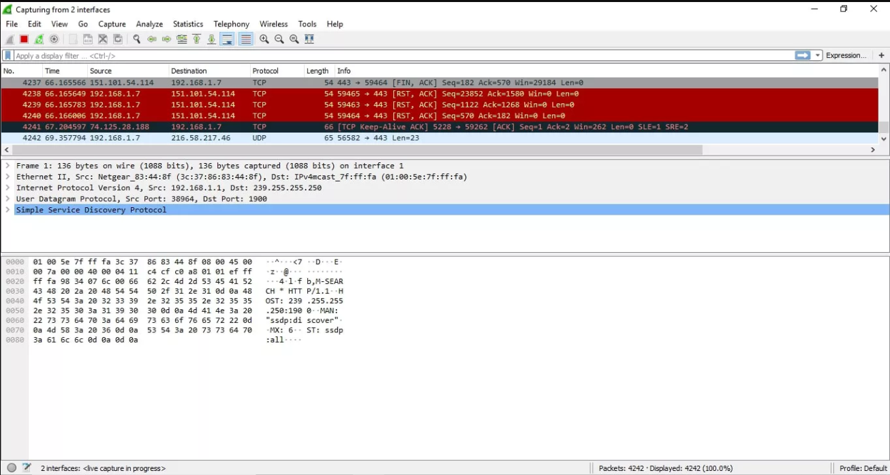
How to View and Analyze Packet Contents
The captured data interface contains three main sections:
The packet list pane (the top section)
The packet details pane (the middle section)
The packet bytes pane (the bottom section)

Slide 14
Packet List The packet list pane, located at the top of the window, shows all packets found in the active capture file. Each packet has its own row and corresponding number assigned to it, along with each of these data points:
No: This field indicates which packets are part of the same conversation. It remains blank until you select a packet.
Time: The timestamp of when the packet was captured is displayed in this column. The default format is the number of seconds or partial seconds since this specific capture file was first created.
Source: This column contains the address (IP or other) where the packet originated.
Destination: This column contains the address that the packet is being sent to.
Protocol: The packet's protocol name, such as TCP, can be found in this column.
Length: The packet length, in bytes, is displayed in this column.
Info: Additional details about the packet are presented here. The contents of this column can vary greatly depending on packet contents.

Slide 15
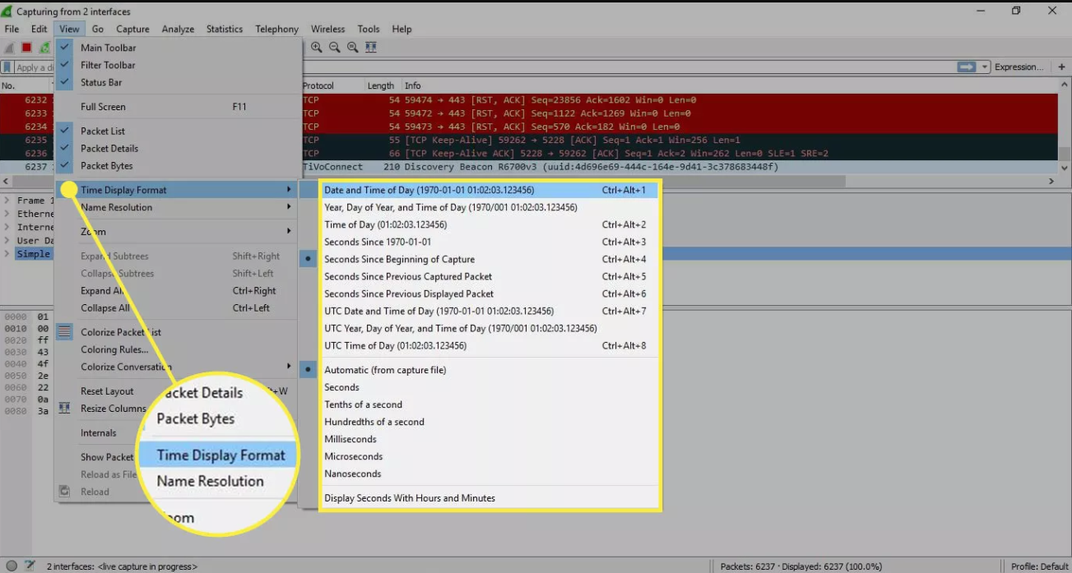
To change the time format to something more useful (such as the actual time of day), select View > Time Display Format.

Slide 16
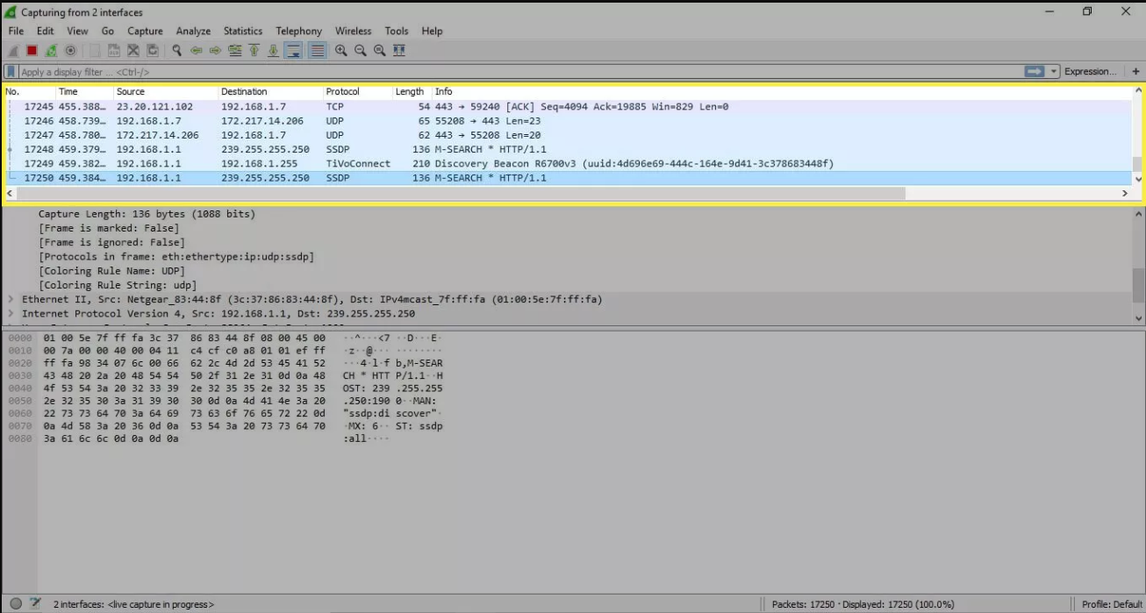
When a packet is selected in the top pane, you may notice one or more symbols appear in the No. column. Open or closed brackets and a straight horizontal line indicate whether a packet or group of packets are part of the same back-and-forth conversation on the network. A broken horizontal line signifies that a packet is not part of the conversation.

Slide 17
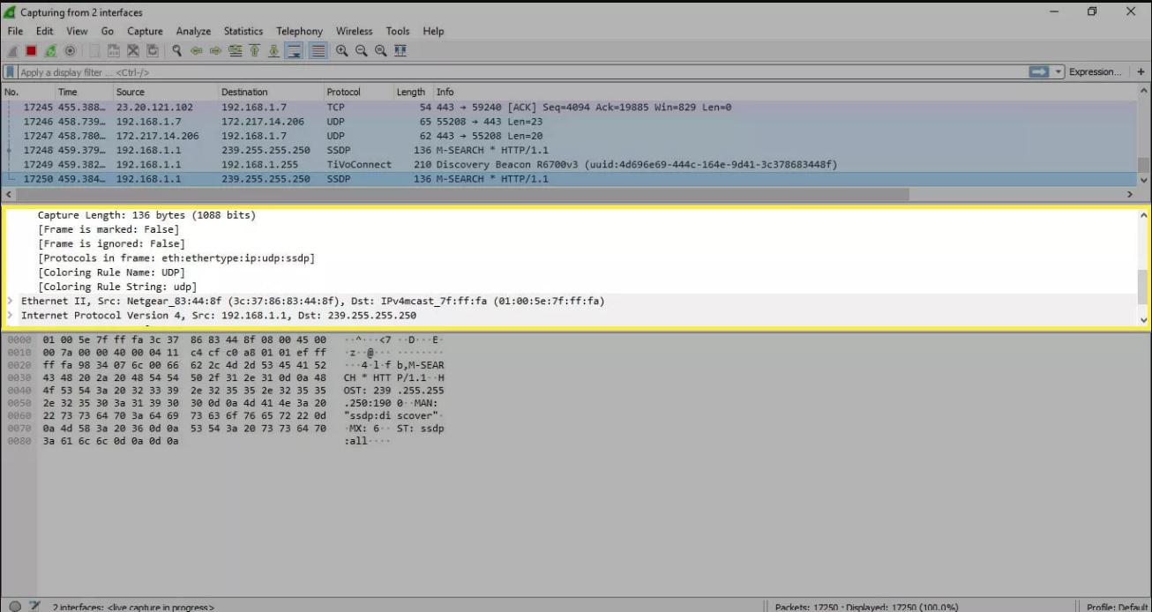
Packet Details
The details pane, found in the middle, presents the protocols and protocol fields of the selected packet in a collapsible format. In addition to expanding each selection, you can apply individual Wireshark filters based on specific details and follow streams of data based on protocol type by right-clicking the desired item.

Slide 18
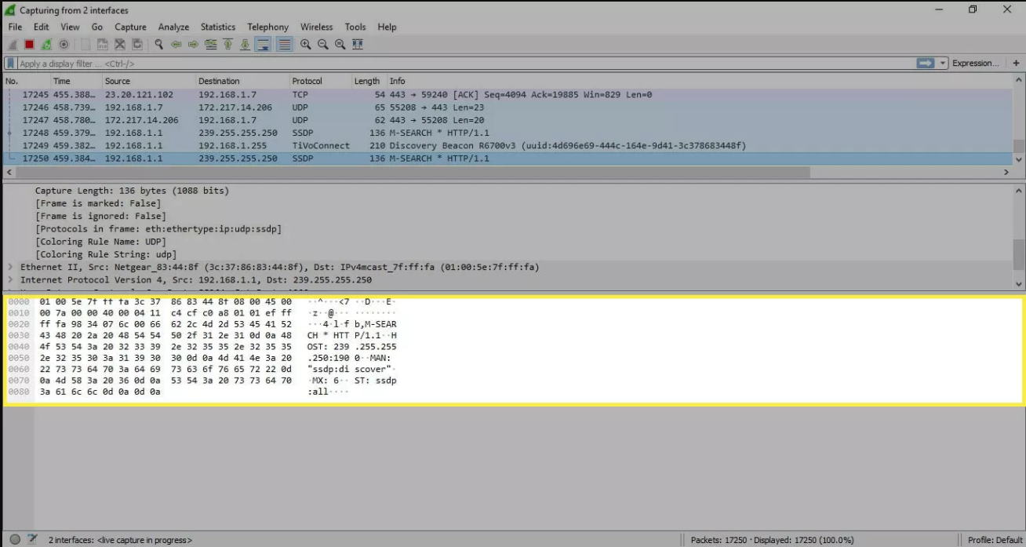
Packet Bytes
At the bottom is the packet bytes pane, which displays the raw data of the selected packet in a hexadecimal view. This hex dump contains 16 hexadecimal bytes and 16 ASCII bytes alongside the data offset.
Selecting a specific portion of this data automatically highlights its corresponding section in the packet details pane and vice versa. Any bytes that cannot be printed are represented by a period.

Slide 19
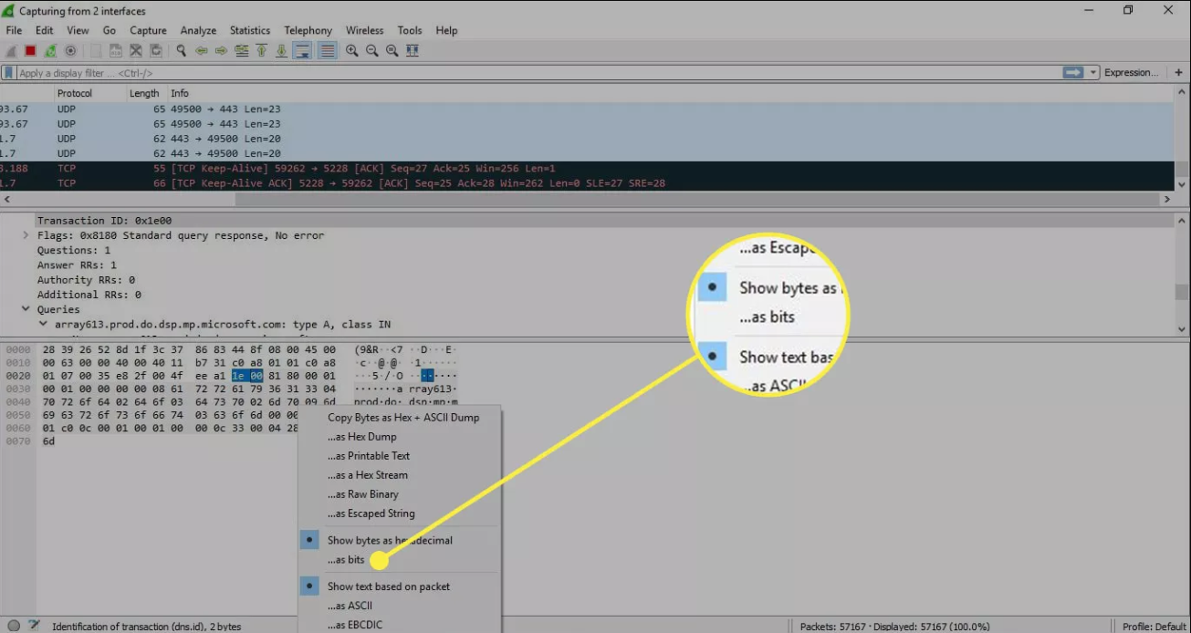
To display this data in bit format as opposed to hexadecimal, right-click anywhere within the pane and select as bits.

Slide 20
How to Use Wireshark Filters?
Capture filters instruct Wireshark to only record packets that meet specified criteria. Filters can also be applied to a capture file that has been created so that only certain packets are shown. These are referred to as display filters.
Wireshark provides a large number of predefined filters by default. To use one of these existing filters, enter its name in the Apply a display filter entry field located below the Wireshark toolbar or in the Enter a capture filter field located in the center of the welcome screen.

Slide 21
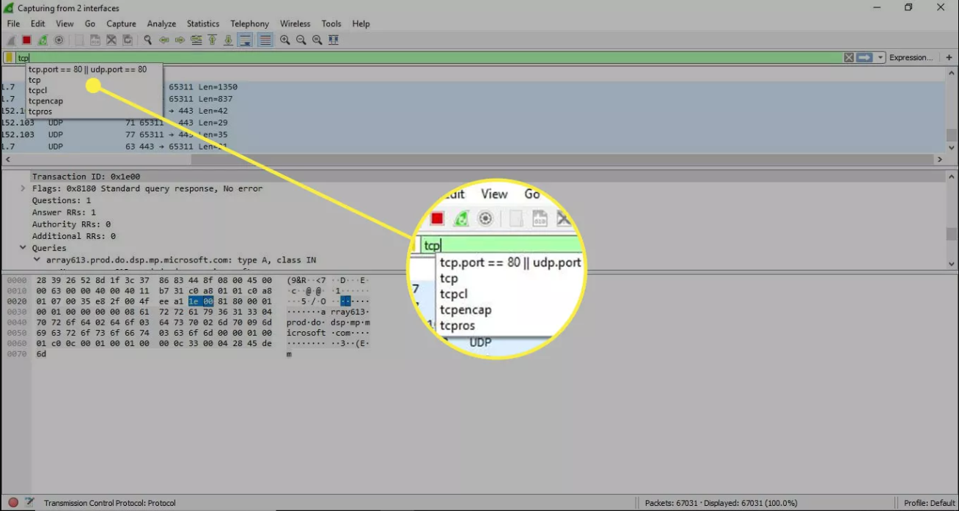
For example, if you want to display TCP packets, type tcp. The Wireshark autocomplete feature shows suggested names as you begin typing, making it easier to find the correct moniker for the filter you're seeking.

Slide 22
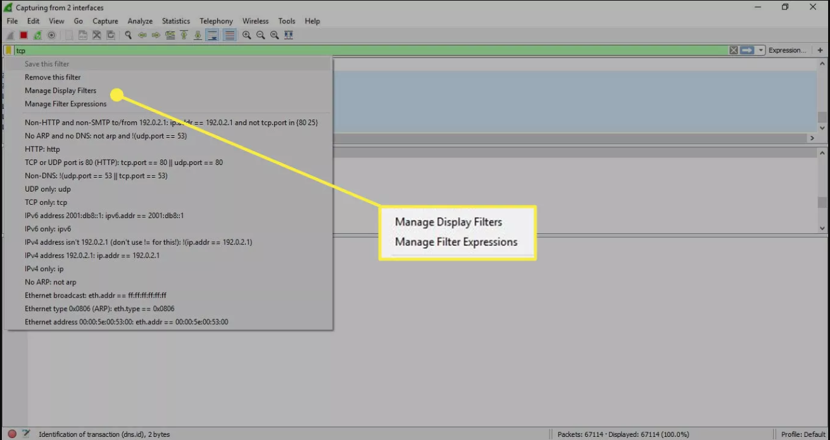
Another way to choose a filter is to select the bookmark on the left side of the entry field. Choose Manage Filter Expressions or Manage Display Filters to add, remove, or edit filters.

Slide 23
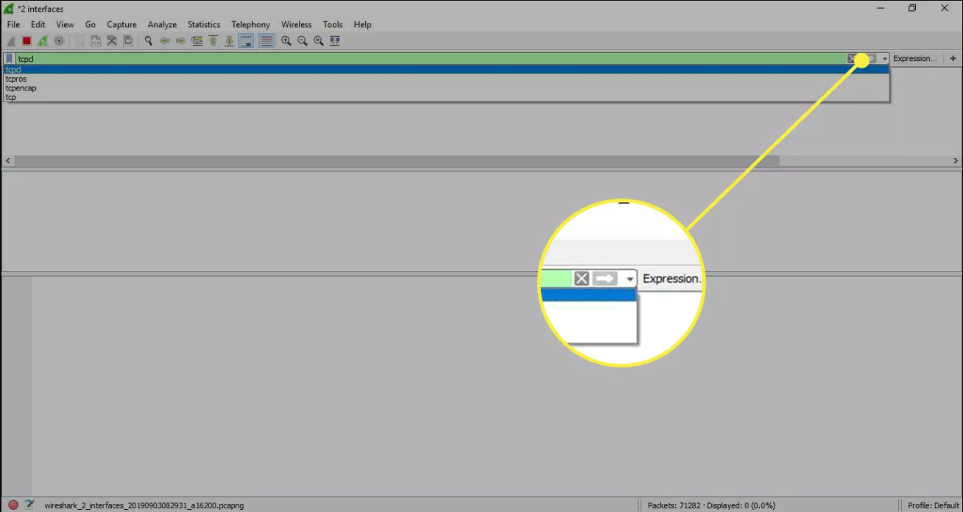
You can also access previously used filters by selecting the down arrow on the right side of the entry field to display a history drop-down list.
Capture filters are applied as soon as you begin recording network traffic. To apply a display filter, select the right arrow on the right side of the entry field.

Slide 24
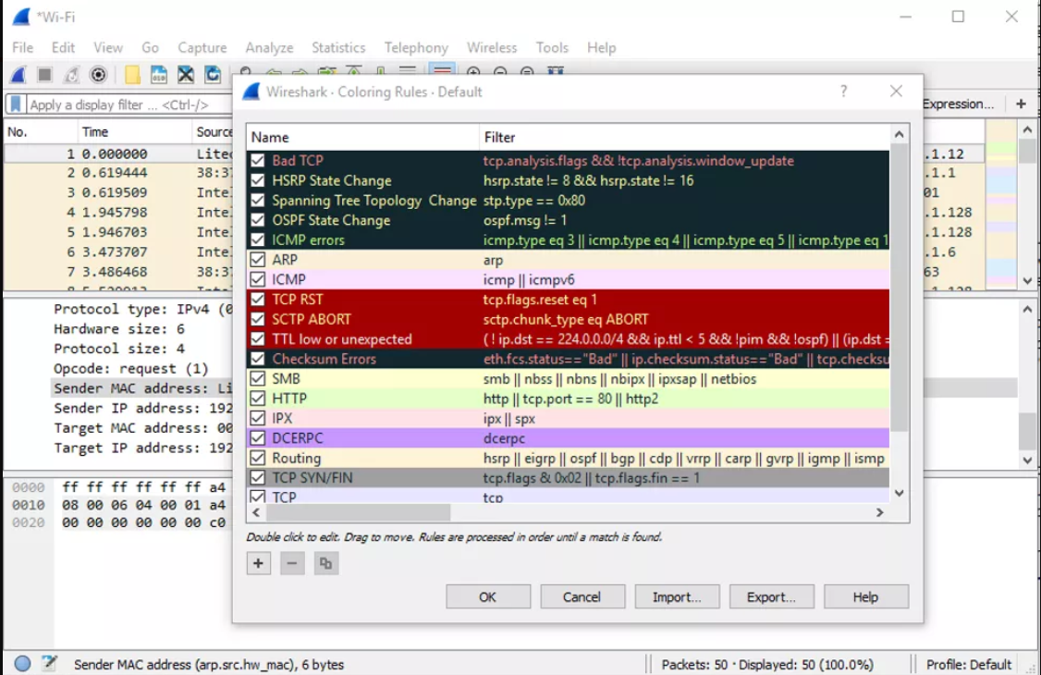
Wireshark Color Rules
While Wireshark's capture and display filters limit which packets are recorded or shown on the screen, its colorization function takes things a step further: It can distinguish between different packet types based on their individual hue. This quickly locates certain packets within a saved set by their row color in the packet list pane.

Slide 25
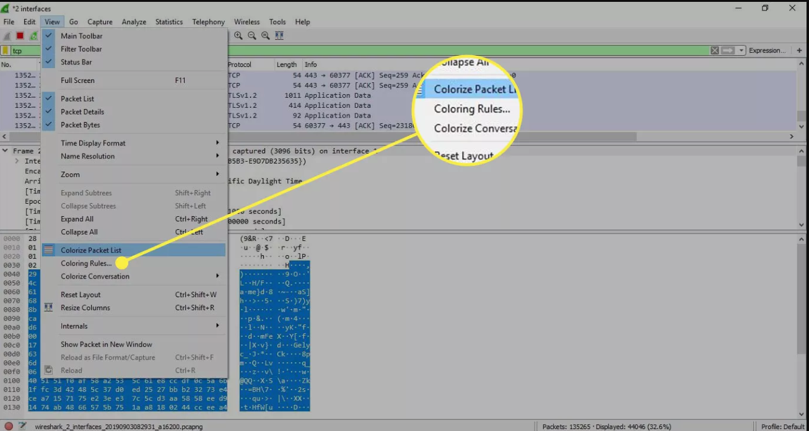
Wireshark comes with about 20 default coloring rules, each can be edited, disabled, or deleted. Select View > Coloring Rules for an overview of what each color means. You can also add your own color-based filters.

Slide 26
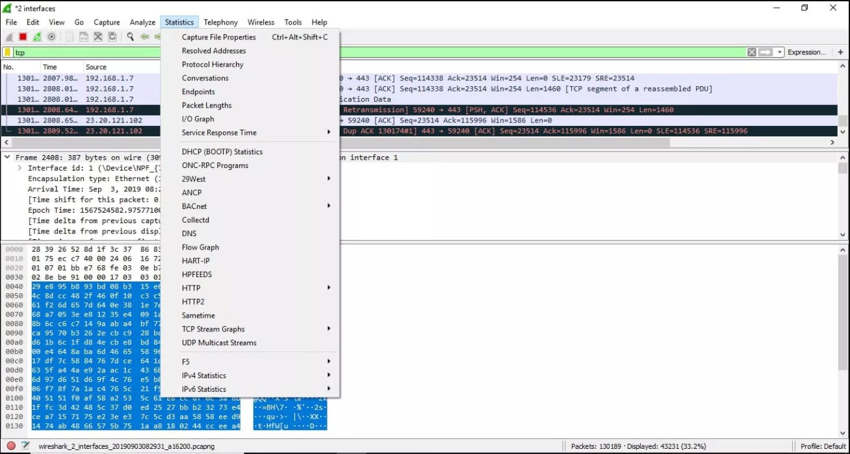
Statistics in Wireshark
Other useful metrics are available through the Statistics drop-down menu. These include size and timing information about the capture file, along with dozens of charts and graphs ranging in topic from packet conversation breakdowns to load distribution of HTTP requests.

Slide 27
Display filters can be applied to many of these statistics via their interfaces, and the results can be exported to common file formats, including CSV, XML, and TXT.

Slide 28
Denial-of-Service (DoS) Attack
A denial-of-service (DoS) attack is a malicious attempt to disrupt or shut down the normal functioning of a targeted server, service, or network by overwhelming it with a flood of illegitimate requests that trigger a crash. This causes the target to become slow, unresponsive, or utterly inaccessible to legitimate users. These malicious endeavors can cripple websites, disrupt services, and cause significant financial and reputational damage.
For example tool-XERXES

Slide 29
XERXES is a free and Open source tool available on GitHub. You can install and download the tool free of cost. A denial of service attack can be performed by using this tool. Xerxes is written in C. The framework works by maintaining a full TCP connection. After making full TCP Connection it only requires a few hundreds of requests at long term in regular intervals. As a result, Xerxes doesn’t need to spend lots of traffic requests to exhaust all the available connections on a server. Using xerxes any remote machine can be taken down or any server can be taken down easily. The tool use perfectly legitimate HTTP traffic. The tool is very useful for security testing.

Slide 30
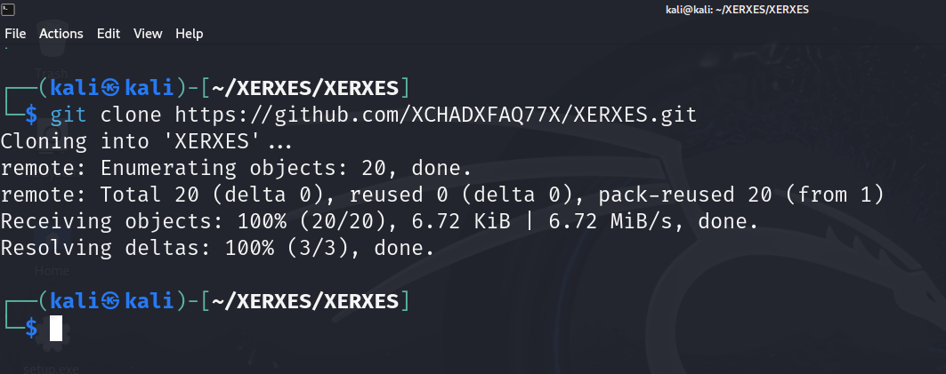
Installation
Step 1: Open your kali linux operating system and use the following command to install the tool from github.
git clone https://github.com/XCHADXFAQ77X/XERXES.git

Slide 31
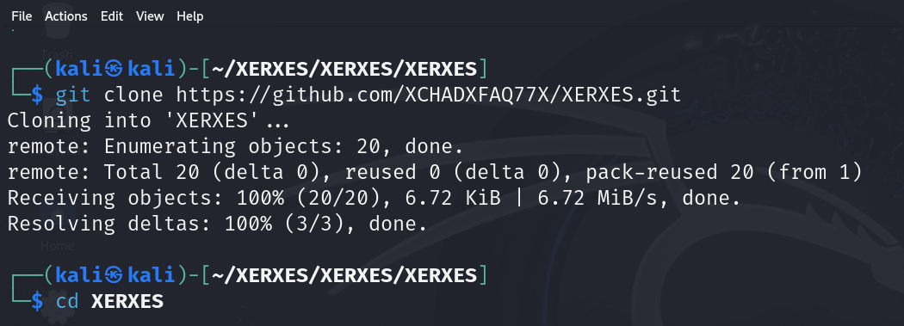
Step 2: Now use the following command to move into the directory of the tool.
cd XERXES

Slide 32
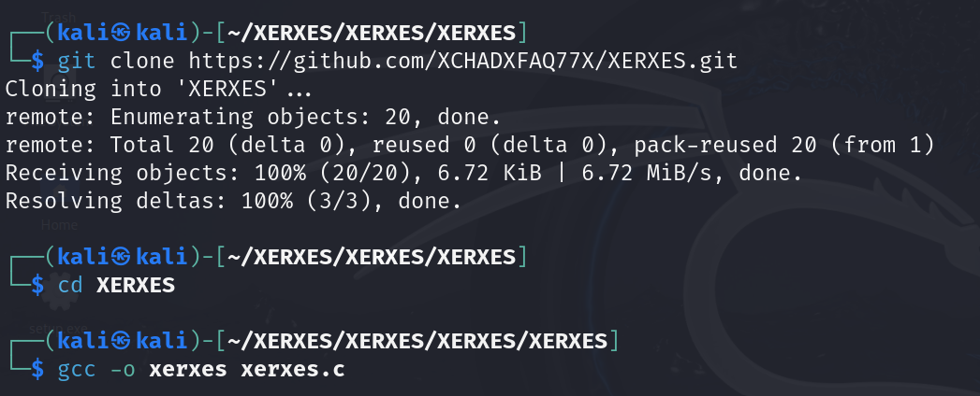
Step 3: Now use the following command to move into the compile of the tool.
gcc -o xerxes xerxes.c

Slide 33
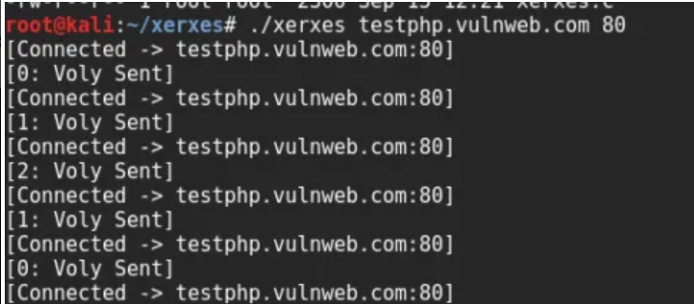
Step 3: Now you are the directory of the tool. Use the following command to start dos attack.
./xerxes IP/DOMAIN 80

